Slide 1
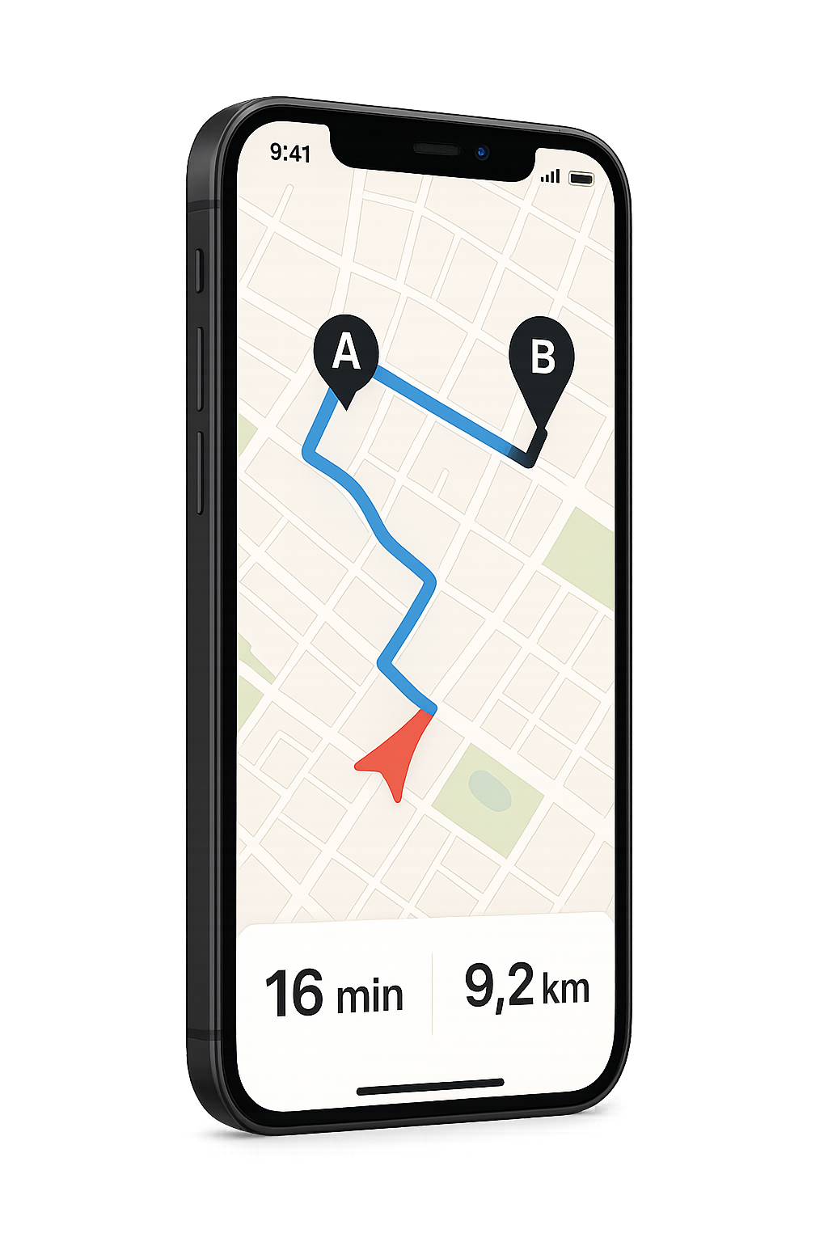


AI-Based Model for Route Optimization in Urban Transportation
Presenter
Murad Babayev Supervisor
Tabriz Osmanli
National Aviation Academy, Group 2451i

Slide 2

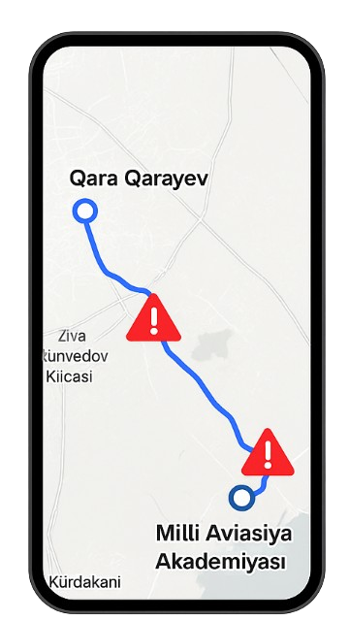


AI-Based Optimization of Urban Transport Routes in Azerbaijan
Presenter
Murad Babayev Supervisor
Tabriz Osmanli
National Aviation Academy, Group 2451i
Problem
Dijkstra’s Algorithm
Genetic Algorithm
In Baku, and other cities across Azerbaijan, moving around has become more of a challenge than it used to be.
Why?
📈 Population is rising
🛣️ Roads don’t follow modern designs
🔁 Traffic changes from day to day
A*
Reinforcement

Slide 3

Problem
In Baku, and other cities across Azerbaijan, moving around has become more of a challenge than it used to be.
AI-Based Optimization of Urban Transport Routes in Azerbaijan
Problem
Why?
In Baku, and other cities across Azerbaijan, moving around has become more of a challenge than it used to be.
Presenter
Murad Babayev Supervisor
Tabriz Osmanli
📈 Population is rising
🛣️ Roads don’t follow modern designs
🔁 Traffic changes from day to day
Why?
📈 Population is rising
🛣️ Roads don’t follow modern designs
🔁 Traffic changes from day to day
National Aviation Academy, Group 2451i
Dijkstra’s Algorithm
Genetic Algorithm
A*
Reinforcement

Slide 4









Problem
In Baku, and other cities across Azerbaijan, moving around has become more of a challenge than it used to be.
AI-Based Optimization of Urban Transport Routes in Azerbaijan
Problem
Why?
In Baku, and other cities across Azerbaijan, moving around has become more of a challenge than it used to be.
Presenter
Murad Babayev Supervisor
Tabriz Osmanli
📈 Population is rising
🛣️ Roads don’t follow modern designs
🔁 Traffic changes from day to day
Why?
📈 Population is rising
🛣️ Roads don’t follow modern designs
🔁 Traffic changes from day to day
National Aviation Academy, Group 2451i
Dijkstra’s Algorithm
Genetic Algorithm
d(u) = min(d(u), d(v) + w(u,v))
Always shortest path, not smartest
Do not consider traffic and another circumstances
Shorter Path
No traffic awareness
~28 min
16,3 km
A*
Reinforcement

Slide 5



Problem
In Baku, and other cities across Azerbaijan, moving around has become more of a challenge than it used to be.
AI-Based Optimization of Urban Transport Routes in Azerbaijan
Problem
Why?
In Baku, and other cities across Azerbaijan, moving around has become more of a challenge than it used to be.
Presenter
Murad Babayev Supervisor
Tabriz Osmanli
📈 Population is rising
🛣️ Roads don’t follow modern designs
🔁 Traffic changes from day to day
Why?
Dijkstra’s Algorithm
📈 Population is rising
🛣️ Roads don’t follow modern designs
🔁 Traffic changes from day to day
National Aviation Academy, Group 2451i
A*
Genetic Algorithm
f(n) = g(n) + h(n)
Distance with some prediction
Adds simple heuristics to avoid congestion
Avoid congestion
Predicts jams
~26 min
16,1 km
Reinforcement

Slide 6


Problem
In Baku, and other cities across Azerbaijan, moving around has become more of a challenge than it used to be.
AI-Based Optimization of Urban Transport Routes in Azerbaijan
Problem
Why?
In Baku, and other cities across Azerbaijan, moving around has become more of a challenge than it used to be.
Presenter
Murad Babayev Supervisor
Tabriz Osmanli
📈 Population is rising
🛣️ Roads don’t follow modern designs
🔁 Traffic changes from day to day
Why?
Dijkstra’s Algorithm
📈 Population is rising
🛣️ Roads don’t follow modern designs
🔁 Traffic changes from day to day
National Aviation Academy, Group 2451i
Genetic Algorithm
$$f\left(x\right)=\sum_{i=1}^{n}{\left(\frac{1}{d\left(x_{i}, x_{i+1}\right)}\right)}$$
This method considered variations of paths
Might be inefficient regarding to time and stability
Explores alternatives
The results not stable
~22 min
16 km
A*
Reinforcement

Slide 7

Problem
In Baku, and other cities across Azerbaijan, moving around has become more of a challenge than it used to be.
AI-Based Optimization of Urban Transport Routes in Azerbaijan
Problem
Why?
In Baku, and other cities across Azerbaijan, moving around has become more of a challenge than it used to be.
Presenter
Murad Babayev Supervisor
Tabriz Osmanli
📈 Population is rising
🛣️ Roads don’t follow modern designs
🔁 Traffic changes from day to day
Why?
Dijkstra’s Algorithm
📈 Population is rising
🛣️ Roads don’t follow modern designs
🔁 Traffic changes from day to day
National Aviation Academy, Group 2451i
Genetic Algorithm
Reinforcement
Q(s,a)=Q(s,a)+α(r+γmax​ Q(s′, a′)−Q(s,a))
Learns on experience and improves with use
Takes time for iterations
Best performance
Takes time for iterations
~18 min
15,5 km
A*

Slide 8

Problem
In Baku, and other cities across Azerbaijan, moving around has become more of a challenge than it used to be.
AI-Based Optimization of Urban Transport Routes in Azerbaijan
Problem
Why?
In Baku, and other cities across Azerbaijan, moving around has become more of a challenge than it used to be.
Presenter
Murad Babayev Supervisor
Tabriz Osmanli
📈 Population is rising
🛣️ Roads don’t follow modern designs
🔁 Traffic changes from day to day
Why?
📈 Population is rising
🛣️ Roads don’t follow modern designs
🔁 Traffic changes from day to day
National Aviation Academy, Group 2451i
Dijkstra’s Algorithm
Genetic Algorithm
A*
Reinforcement

Slide 9
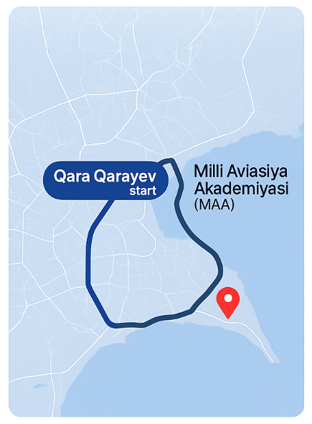
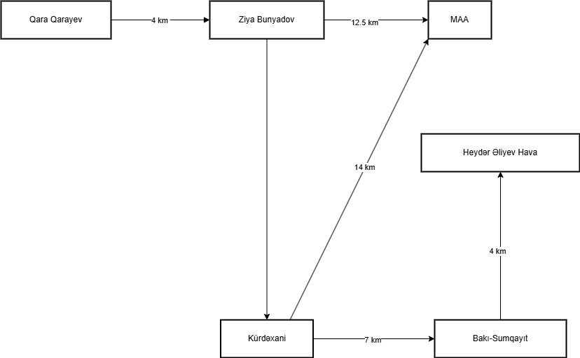

Problem
In Baku, and other cities across Azerbaijan, moving around has become more of a challenge than it used to be.
AI-Based Optimization of Urban Transport Routes in Azerbaijan
Problem
Why?
In Baku, and other cities across Azerbaijan, moving around has become more of a challenge than it used to be.
Presenter
Murad Babayev Supervisor
Tabriz Osmanli
📈 Population is rising
🛣️ Roads don’t follow modern designs
🔁 Traffic changes from day to day
Why?
📈 Population is rising
🛣️ Roads don’t follow modern designs
🔁 Traffic changes from day to day
National Aviation Academy, Group 2451i
Dijkstra’s Algorithm
d(u) = min(d(u), d(v) + w(u,v))
d(u) – current known shortest distance from the start node to node u
d(v) – current shortest distance from the start node to node v (a neighbor)
w(u, v) – the weight (or cost) of the edge between node v and node u (e.g., distance or traffic factor)
Step | From → To | Distance (km) | Traffic Factor | Adjusted Weight
1 | Qara Qarayev → Ziya Bünyadov | 4.0 | 1.8 (80%) | 7.2
2 | Ziya Bünyadov → Kürdəxanı | 6.0 | 1.7 (70%) | 10.2
3 | Kürdəxanı → MAA | 7.5 | 1.6 (60%) | 12.0

Slide 10
Dijkstra’s Algorithm
d(u) = min(d(u), d(v) + w(u,v))
Problem
d(u) – current known shortest distance from the start node to node u
d(v) – current shortest distance from the start node to node v (a neighbor)
w(u, v) – the weight (or cost) of the edge between node v and node u (e.g., distance or traffic factor)
In Baku, and other cities across Azerbaijan, moving around has become more of a challenge than it used to be.
AI-Based Optimization of Urban Transport Routes in Azerbaijan
Problem
Why?
In Baku, and other cities across Azerbaijan, moving around has become more of a challenge than it used to be.
Presenter
Murad Babayev Supervisor
Tabriz Osmanli
📈 Population is rising
🛣️ Roads don’t follow modern designs
🔁 Traffic changes from day to day
Why?
📈 Population is rising
🛣️ Roads don’t follow modern designs
🔁 Traffic changes from day to day
National Aviation Academy, Group 2451i
Step | From → To | Distance (km) | Traffic Factor | Adjusted Weight
1 | Qara Qarayev → Ziya Bünyadov | 4.0 | 1.8 (80%) | 7.2
2 | Ziya Bünyadov → Kürdəxanı | 6.0 | 1.7 (70%) | 10.2
3 | Kürdəxanı → MAA | 7.5 | 1.6 (60%) | 12.0

Slide 11
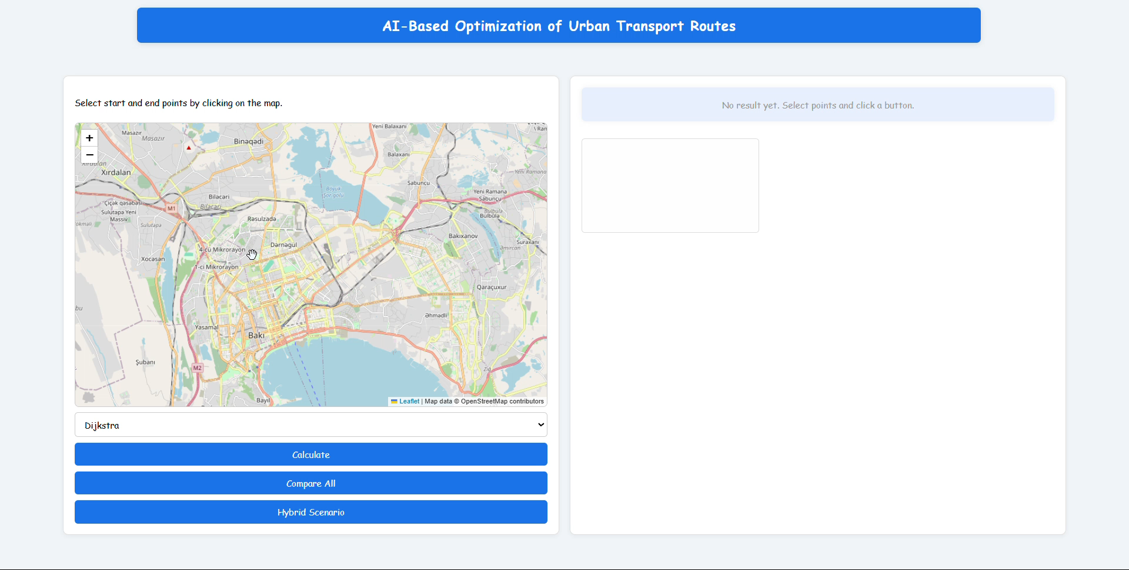
Dijkstra’s Algorithm
d(u) = min(d(u), d(v) + w(u,v))
Problem
d(u) – current known shortest distance from the start node to node u
d(v) – current shortest distance from the start node to node v (a neighbor)
w(u, v) – the weight (or cost) of the edge between node v and node u (e.g., distance or traffic factor)
In Baku, and other cities across Azerbaijan, moving around has become more of a challenge than it used to be.
AI-Based Optimization of Urban Transport Routes in Azerbaijan
Problem
Why?
In Baku, and other cities across Azerbaijan, moving around has become more of a challenge than it used to be.
Presenter
Murad Babayev Supervisor
Tabriz Osmanli
📈 Population is rising
🛣️ Roads don’t follow modern designs
🔁 Traffic changes from day to day
Why?
📈 Population is rising
🛣️ Roads don’t follow modern designs
🔁 Traffic changes from day to day
National Aviation Academy, Group 2451i

Slide 12
Dijkstra’s Algorithm
Genetic Algorithm
Fast but static
Exploratory
Hybrid
Adaptive & Intelligent
Predictive
A*
Reinforcement

Slide 13
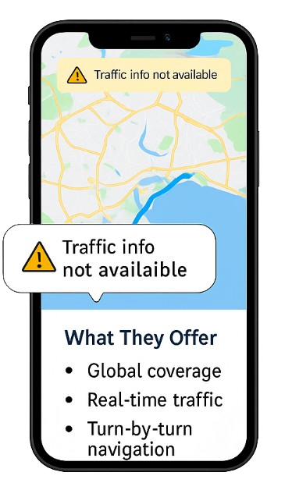
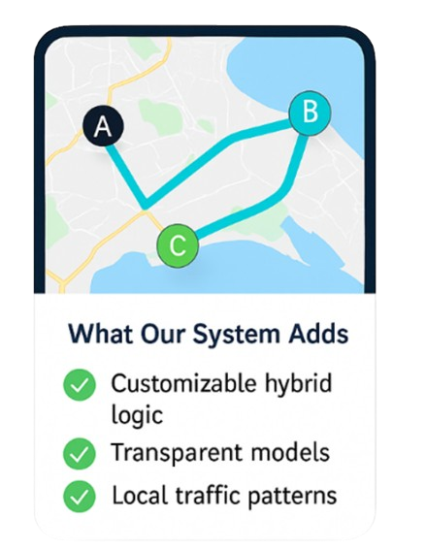


⚠️No customization
📊 Public Transport Operators Efficient, flexible routing based on real-time traffic and passenger demand.
🚚 Logistics & Ride-Sharing Companies Reduced delays, fuel savings, and smarter delivery scheduling.
🚗 Everyday Users Personalized routes that adapt to real-world conditions — not just the shortest path.
❌Lack of localized data
❌Doesn’t adapt to local patterns

Slide 14

It shows how smart routing can adapt to local realities.
Real-time GPS & traffic integration
User behavior learning (e.g., preferences, driving patterns)

Slide 15






Thanks for your attention!!
Any Questions ?
mbabayev
mb.official.444@gmail.com
XENOPHIR
+994 (050) 633 95 76

